Slide 1
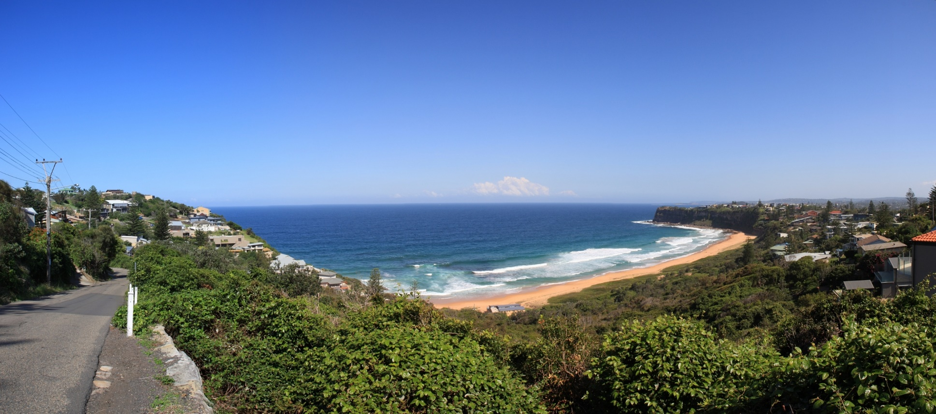
Liveable Sydney
Lee Ping Tan
25 March 2019

Slide 2
Objective
- To segment Sydney suburbs according to its liveability factors, compare the median house price among similar suburbs and identify a better value suburb, if any
Target Audience
- potential property buyer, property investor and real estate agents

Slide 3


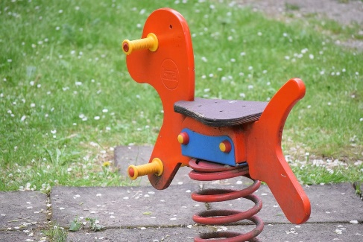





What are liveable factors of a suburb?

Slide 4




Data Sources
Digital
Advocates
Just Web

Slide 5
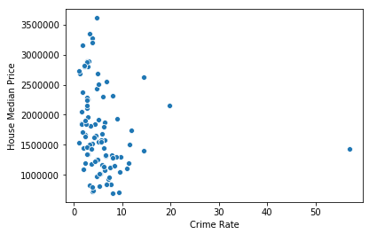
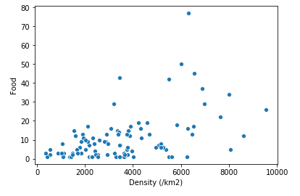
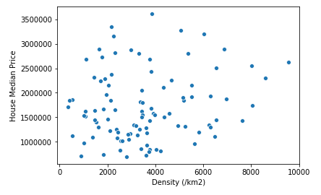
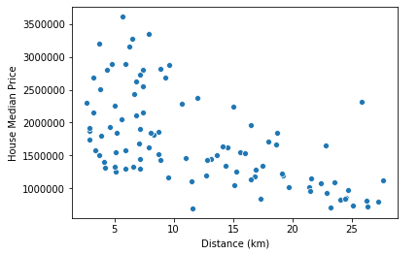
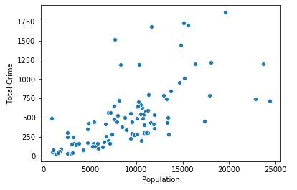
A Peek on the Data

Slide 6
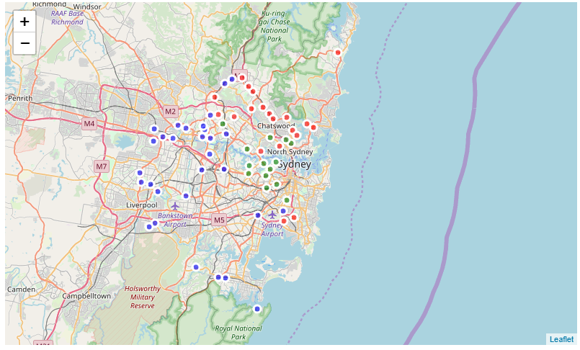



Results
Cluster 1
Cluster 2
Cluster 3

Slide 7
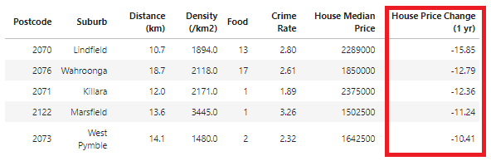
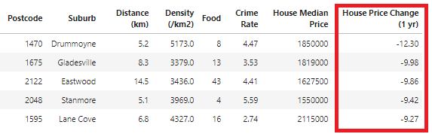
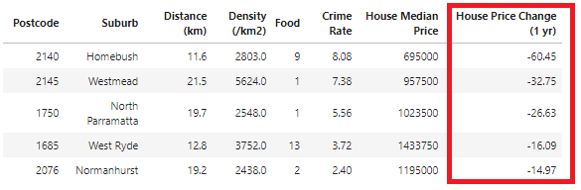
Suburbs with huge price change

Slide 8
Conclusion
Data collection and data cleaning is time consuming
No domain expert available
Insufficient data, ex. FourSquare location data does not provide true value for venue count
Big room for improvement

Slide 9

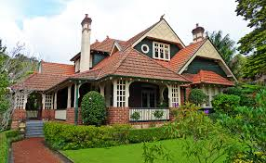

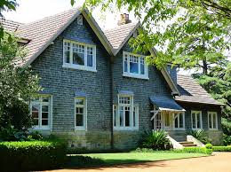
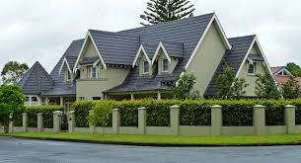


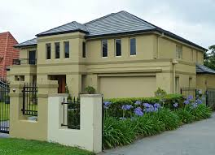
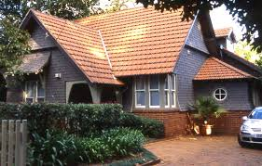
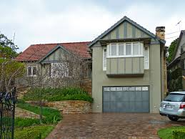

Into the Future ..
Sourcing more reliable data
Include other interesting features like look and feel of each suburb

